Slide 1


Slide 2

Web-based Fitness Management System

Slide 3
Group Members Introduction
Name: Fatima Pir
VUID: BC200201057
Group Id: S25PROJECT73EE2
Supervisor Name: Qaiser Shabbir

Slide 4

INTRODUCTION OF PROJECT
This design document outlines the architecture, components, and functional flow of the Web-based Fitness Management System. It includes detailed descriptions of system entities (Admin, Member, Trainer), database design, user interface layouts, functional and non-functional requirements, and overall interaction between modules. The document also presents data flow diagrams, entity-relationship diagrams, and system architecture to visualize the inner workings of the system.

Slide 5
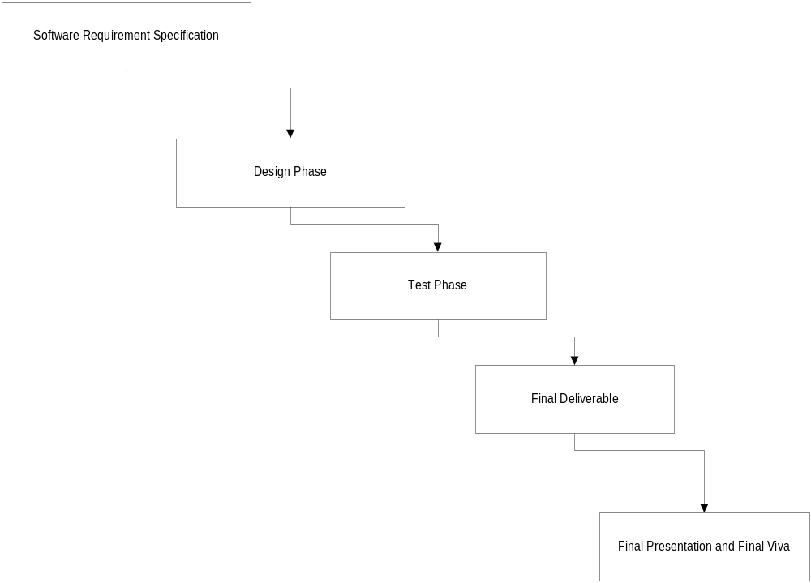
Process Diagram

Slide 6
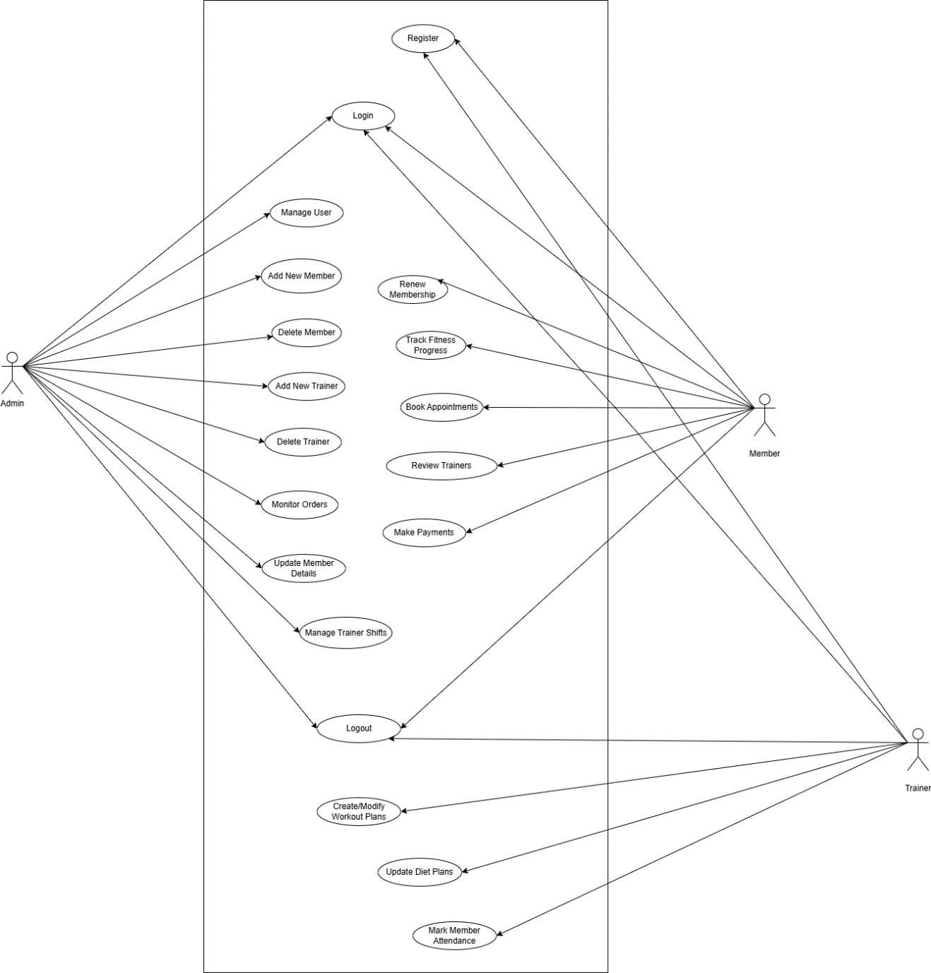
Use Case Diagram

Slide 7
Business Rules Catalog
Functional Requirements:
Admin Functionalities:
Login/logout using credentials.
Add, modify, or delete member and trainer records.
Manage trainer profiles, availability, and shift schedules.
Member Functionalities:
Register, log in, and purchase or renew membership plans.
Log fitness progress and track historical data.
Book appointments with trainers and classes.
Review and rate trainers.
Secure online payment integration.

Slide 8
Business Rules Catalog
Functional Requirements:
Trainer Functionalities:
Login/logout using credentials.
Create, assign, and modify workout and diet plans.
Mark attendance of members.
View and manage appointment schedules.
Common Features:
Automated notifications via email/SMS for updates.
User-friendly dashboards for each role

Slide 9
Architectural Design
Presentation Layer
Application Layer
Database Layer
Database

Slide 10
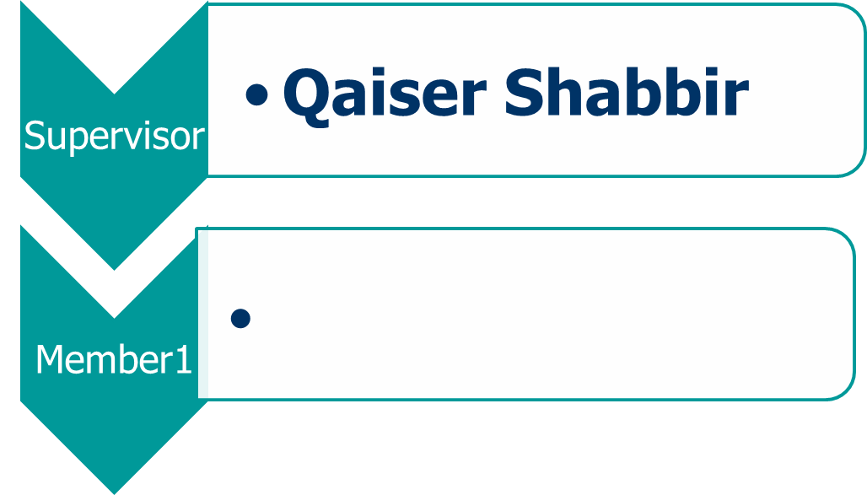
Team Structure

Slide 11
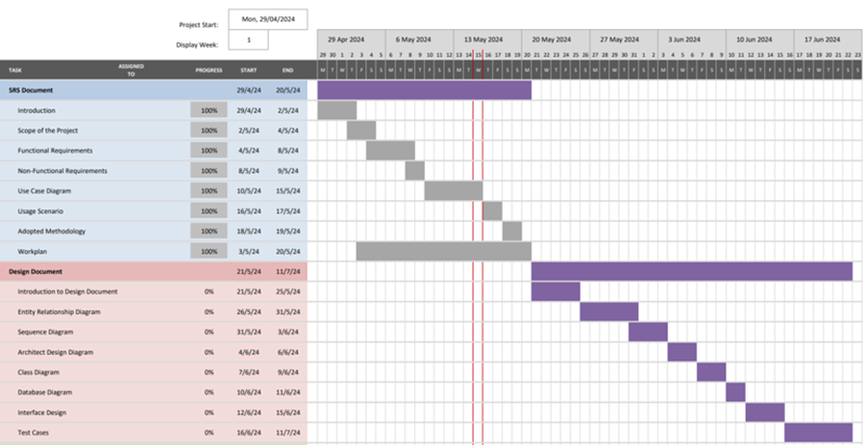
Project Schedule

Slide 12
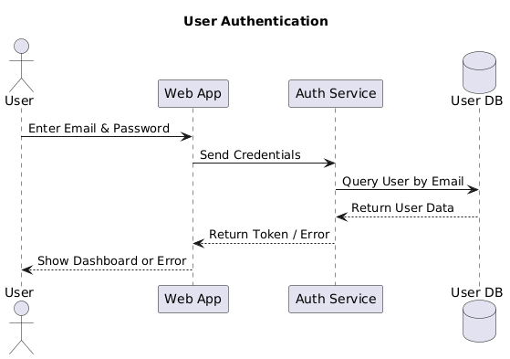
Sequence Diagrams

Slide 13
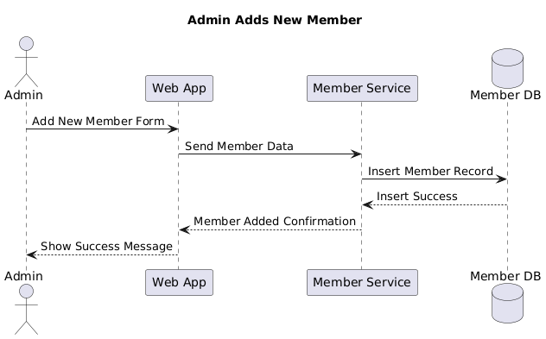
Sequence Diagrams

Slide 14
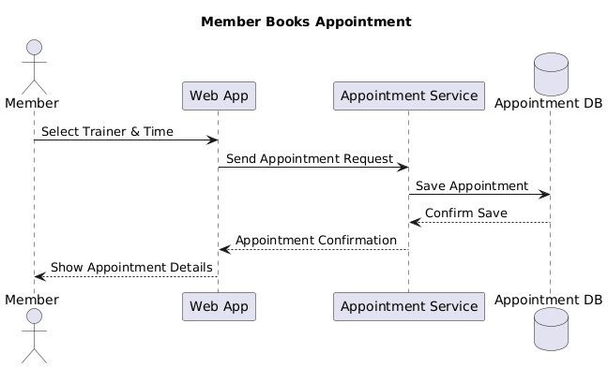
Sequence Diagrams

Slide 15
Sequence Diagrams

Slide 16
Sequence Diagrams

Slide 17
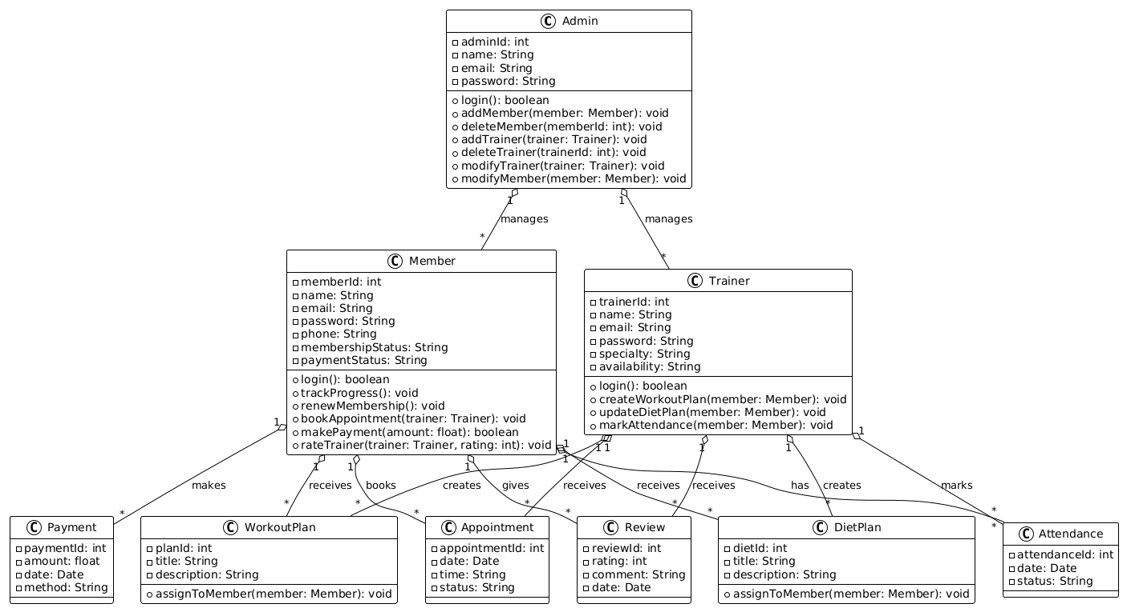
Logical Model/Class Diagram

Slide 18
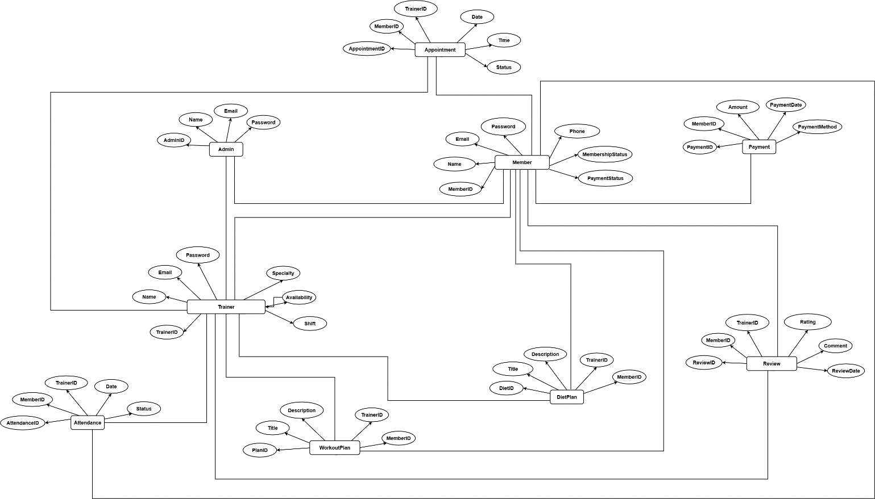
Entity-Relationship Diagram

Slide 19
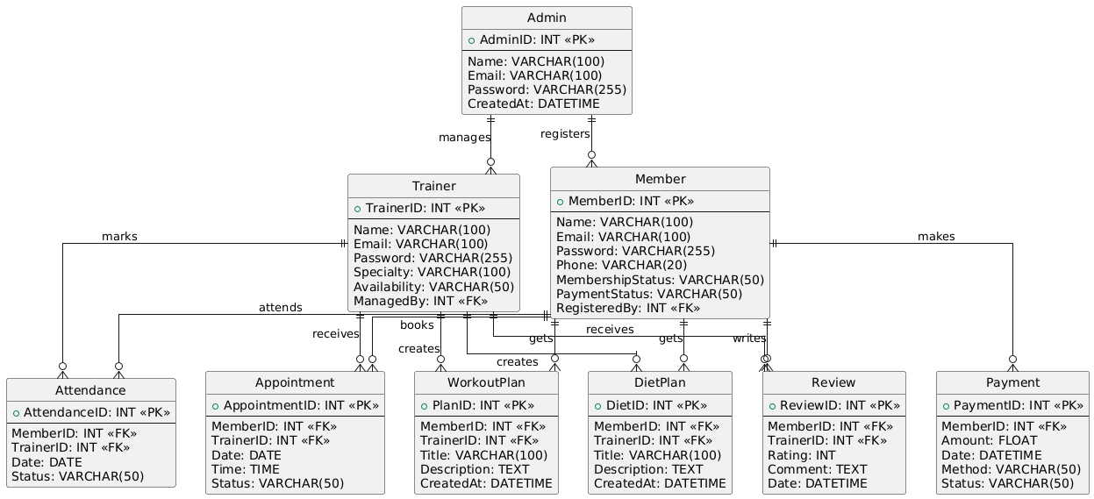
Database Diagram

Slide 20
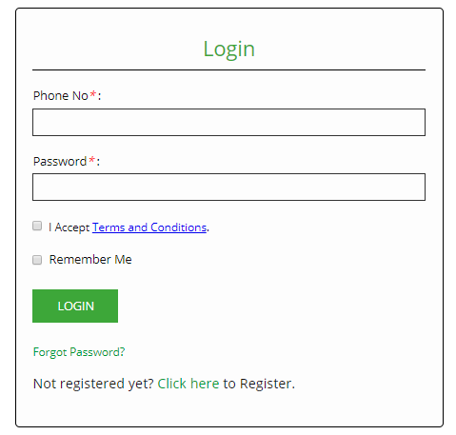
User Interfaces

Slide 21
Tools
Microsoft Visual Studio
Sublime
SQL Server

